Slide 1
ACE Direct v2.1
Consumer Portal Operations Checklist

Slide 2
Purpose
This checklist demonstrates the ACE Direct functionality for the consumer using the online portal.
It provides a step-by-step walkthrough to verify each of the consumer’s operational functions.
Note: For additional information, please reference the ACE Direct Platform Release Documentation, Release 2.1.

Slide 3
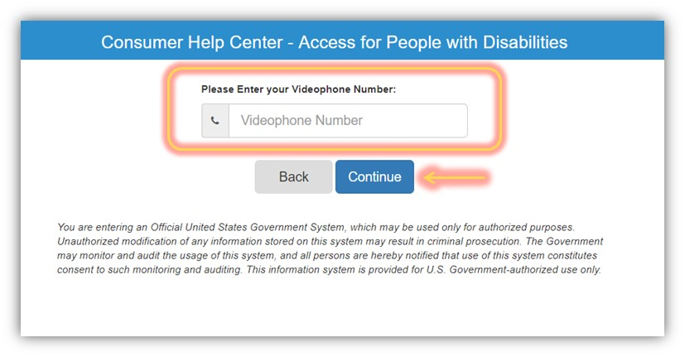
Step 1: Log into Consumer Portal
Purpose:
Verify account access to the portal.
Navigate to the consumer portal.
Enter a valid VRS phone number and click “Continue”.
You should be redirected to the consumer portal.
ACE Direct Platform Release Documentation, Release 2.1
Subsection 2.8.1.1

Slide 4
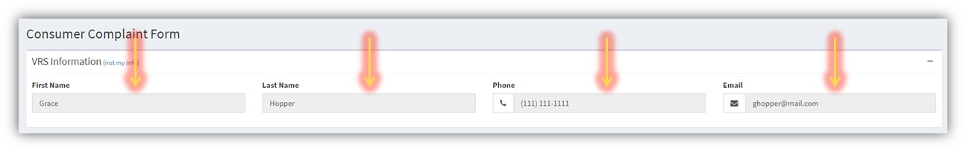
Step 2: Verify Account Information
Purpose:
Verify account information.
Validate the VRS Information displayed is the correct for the VRS account.
ACE Direct Platform Release Documentation, Release 2.1
Subsection 2.9.1.2

Slide 5
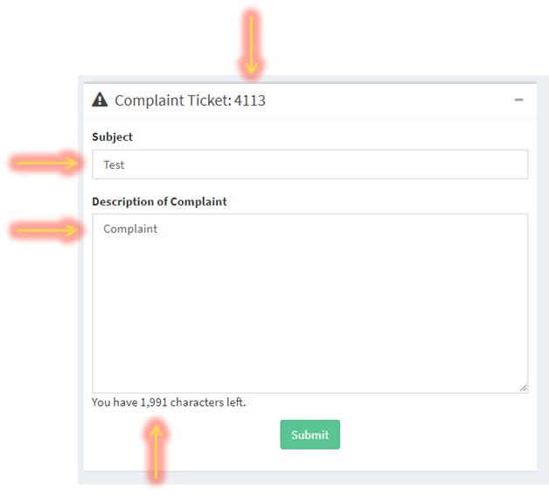
Step 3: Submit a Ticket
Purpose:
Verify ticket submission.
Enter a subject for the complaint in the “Subject” text field.
Enter a description for the complaint in the appropriate text field.
The character count should decrease as you type the description.
Select “Submit” and a ticket number should appear in the header.
ACE Direct Platform Release Documentation, Release 2.1
Subsection 2.8.1.3

Slide 6
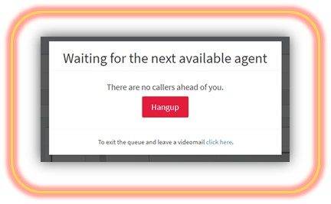
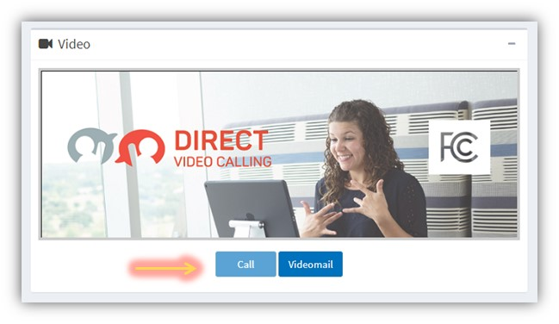
Step 4: Video Communications
Purpose:
Verify video and chat communications.
Select “Call” in the video window. This button will not work until a ticket is submitted.
A pop-up window should appear notifying the caller they are in the queue waiting for the next available agent.
Once connected, the agents video should appear in the video window with your video appearing in the top right of the corner.
ACE Direct Platform Release Documentation, Release 2.1
Subsection 2.8.1.4

Slide 7
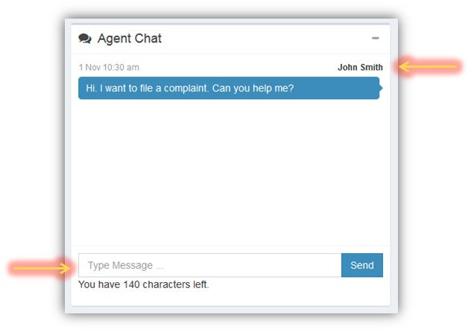
Step 5: Real-time Text Chat Communications
Purpose:
Verify Real-time Text Chat.
Once connected, enter a message into the text field of the Agent Chat window and select “Send”.
The text will be committed to the chat window with the Consumer’s name above the text bubble.
The other party’s text should appear above you text input field in grey text as they type. This can be seen on both the Agent and Consumer side.
A counter below the input field should display the remaining number of characters left for each message.
ACE Direct Platform Release Documentation, Release 2.1
Subsection 2.8.2

Slide 8
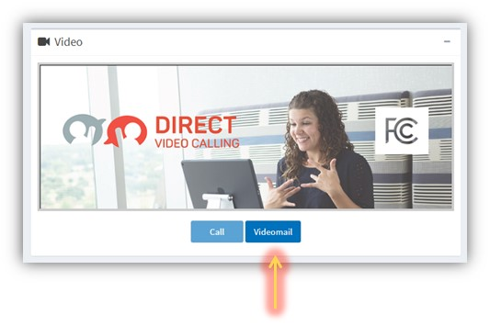
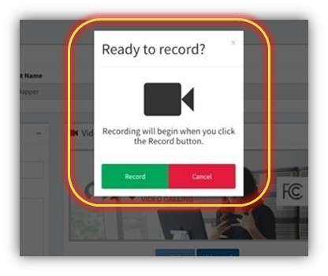

Step 6: Leave a Videomail
Purpose:
Verify Video Mail functionality.
Select the “Videomail” button in the video window.
A pop-up window should appear asking “Ready to Record”.
Select “Record” and your video will be displayed in the video window as the message is recorded.
ACE Direct Platform Release Documentation Release 2.1
Subsection 2.8.3

Slide 9
Notice
This work was produced for the U. S. Government under Contract Number HHSM-5000-2012-000081, and is subject to Federal Acquisition Regulation Clause 52.227-14, Rights in Data—General, Alt. II, III and IV (DEC 2007) [Reference 27.409(a)].
No other use other than that granted to the U. S. Government, or to those acting on behalf of the U. S. Government under that Clause, is authorized without the express written permission of The MITRE Corporation.
For further information, please contact The MITRE Corporation, Contracts Management Office, 7515 Colshire Drive, McLean, VA 22102-7539, (703) 983-6000.
©2018 The MITRE Corporation. All Rights Reserved.

